Slide 1

LECTURE 5_2: Use Cases
Instructor: Maria Striki
Presentation: Ivan Marsic, Maria Striki
Rutgers University

Slide 2
Topics
Actors, Goals
Sketchy/Summary Use Cases
Use Case Diagram
Traceability Matrix
System Boundary and Subsystems
Detailed Use Case Specification
System Sequence Diagrams
Security and Risk Management

Slide 3
Agile Development Techniques

Slide 4
Extreme programming
A very influential agile method, developed in the late 1990s, that introduced a range of agile development techniques.
Extreme Programming (XP) takes an ‘extreme’ approach to iterative development.
  New versions may be built several times per day;
  Increments are delivered to customers every 2 weeks;
  All tests must be run for every build and the build is only accepted if tests run successfully.

Slide 5
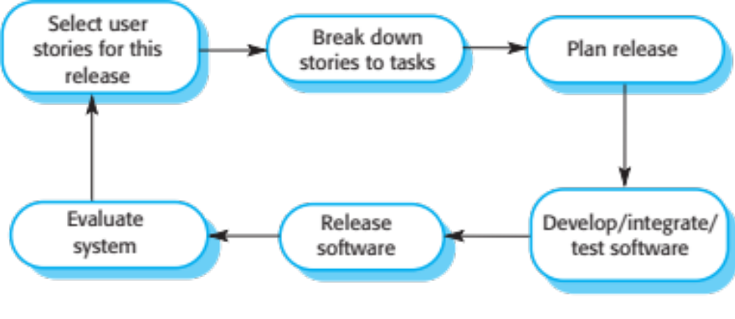
The extreme programming release cycle

Slide 6
Extreme programming practices (a)
Principle or practice | Description
Incremental planning | Requirements are recorded on story cards and the stories to be included in a release are determined by the time available and their relative priority. The developers break these stories into development ‘Tasks’. See Figures 3.5 and 3.6.
Small releases | The minimal useful set of functionality that provides business value is developed first. Releases of the system are frequent and incrementally add functionality to the first release.
Simple design | Enough design is carried out to meet the current requirements and no more.
Test-first development | An automated unit test framework is used to write tests for a new piece of functionality before that functionality itself is implemented.
Refactoring | All developers are expected to refactor the code continuously as soon as possible code improvements are found. This keeps the code simple and maintainable.

Slide 7
Influential XP practices
Extreme programming has a technical focus and is not easy to integrate with management practice in most organizations.
Consequently, while agile development uses practices from XP, the method as originally defined is not widely used.
Key practices
  User stories for specification
  Refactoring
  Test-first development
  Pair programming

Slide 8
User stories for requirements
In XP, a customer or user is part of the XP team and is responsible for making decisions on requirements.
User requirements are expressed as user stories or scenarios.
These are written on cards and the development team break them down into implementation tasks. These tasks are the basis of schedule and cost estimates.
The customer chooses the stories for inclusion in the next release based on their priorities and the schedule estimates.

Slide 9
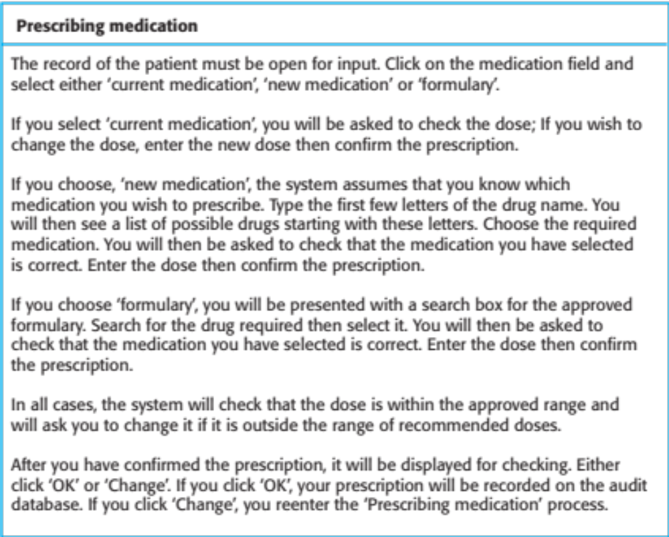
A ‘prescribing medication’ story

Slide 10
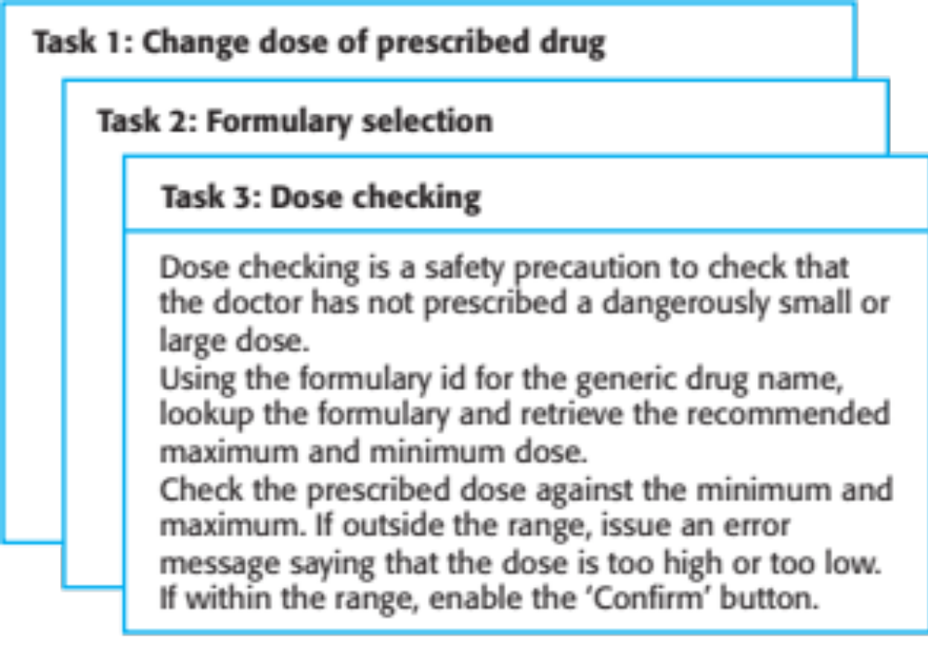
Examples of task cards for prescribing medication

Slide 11
Refactoring
Conventional wisdom in software engineering is to design for change. It is worth spending time and effort anticipating changes as this reduces costs later in the life cycle.
XP, however, maintains that this is not worthwhile as changes cannot be reliably anticipated.
Rather, it proposes constant code improvement (refactoring) to make changes easier when they have to be implemented.

Slide 12
Test-first development
Testing is central to XP and XP has developed an approach where the program is tested after every change has been made.
XP testing features:
  Test-first development.
  Incremental test development from scenarios.
  User involvement in test development and validation.
  Automated test harnesses are used to run all component tests each time that a new release is built.

Slide 13
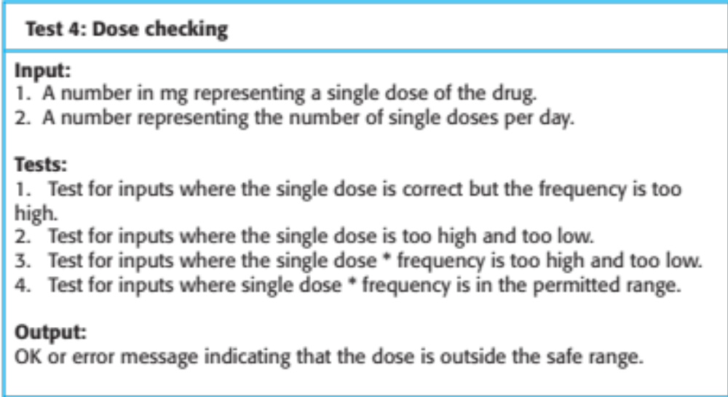
Test case description for dose checking

Slide 14
Problems with test-first development
Programmers prefer programming to testing and sometimes they take short cuts when writing tests. For example, they may write incomplete tests that do not check for all possible exceptions that may occur.
Some tests can be very difficult to write incrementally. For example, in a complex user interface, it is often difficult to write unit tests for the code that implements the ‘display logic’ and workflow between screens.
It difficult to judge the completeness of a set of tests. Although you may have a lot of system tests, your test set may not provide complete coverage.

Slide 16
Pair programming
Pair programming involves programmers working in pairs, developing code together.
This helps develop common ownership of code and spreads knowledge across the team.
It serves as an informal review process as each line of code is looked at by more than 1 person.
It encourages refactoring as the whole team can benefit from improving the system code.

Slide 17
Pair programming
In pair programming, programmers sit together at the same computer to develop the software.
Pairs are created dynamically so that all team members work with each other during the development process.
The sharing of knowledge that happens during pair programming is very important as it reduces the overall risks to a project when team members leave.
Pair programming is not necessarily inefficient and there is some evidence that suggests that a pair working together is more efficient than 2 programmers working separately.

Slide 18
Agile Project Management

Slide 20
Scrum
Scrum is an agile method that focuses on managing iterative development rather than specific agile practices.
There are three phases in Scrum.
  The initial phase is an outline planning phase where you establish the general objectives for the project and design the software architecture.
  This is followed by a series of sprint cycles, where each cycle develops an increment of the system.
  The project closure phase wraps up the project, completes required documentation such as system help frames and user manuals and assesses the lessons learned from the project.
30/10/2014
Chapter 3 Agile Software Development

Slide 21
Scrum terminology (a)
Scrum term | Definition
Development team | A self-organizing group of software developers, which should be no more than 7 people. They are responsible for developing the software and other essential project documents.
Potentially shippable product increment | The software increment that is delivered from a sprint. The idea is that this should be ‘potentially shippable’ which means that it is in a finished state and no further work, such as testing, is needed to incorporate it into the final product. In practice, this is not always achievable.
Product backlog | This is a list of ‘to do’ items which the Scrum team must tackle. They may be feature definitions for the software, software requirements, user stories or descriptions of supplementary tasks that are needed, such as architecture definition or user documentation.
Product owner | An individual (or possibly a small group) whose job is to identify product features or requirements, prioritize these for development and continuously review the product backlog to ensure that the project continues to meet critical business needs. The Product Owner can be a customer but might also be a product manager in a software company or other stakeholder representative.
30/10/2014
Chapter 3 Agile Software Development

Slide 22
Scrum terminology (b)
Scrum term | Definition
Scrum | A daily meeting of the Scrum team that reviews progress and prioritizes work to be done that day. Ideally, this should be a short face-to-face meeting that includes the whole team.
ScrumMaster | The ScrumMaster is responsible for ensuring that the Scrum process is followed and guides the team in the effective use of Scrum. He or she is responsible for interfacing with the rest of the company and for ensuring that the Scrum team is not diverted by outside interference. The Scrum developers are adamant that the ScrumMaster should not be thought of as a project manager. Others, however, may not always find it easy to see the difference.
Sprint | A development iteration. Sprints are usually 2-4 weeks long.
Velocity | An estimate of how much product backlog effort that a team can cover in a single sprint. Understanding a team’s velocity helps them estimate what can be covered in a sprint and provides a basis for measuring improving performance.
30/10/2014
Chapter 3 Agile Software Development

Slide 23
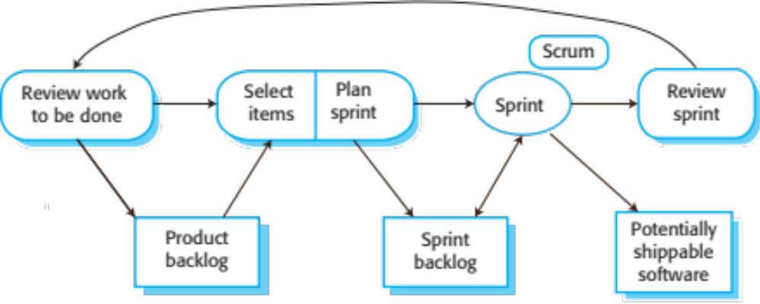
Scrum sprint cycle
30/10/2014
Chapter 3 Agile Software Development

Slide 24
The Scrum sprint cycle
Sprints are fixed length, normally 2–4 weeks.
The starting point for planning is the product backlog, which is the list of work to be done on the project.
The selection phase involves all of the project team who work with the customer to select the features and functionality from the product backlog to be developed during the sprint.
30/10/2014
Chapter 3 Agile Software Development

Slide 25
The Sprint cycle
Once these are agreed, the team organize themselves to develop the software.
During this stage the team is isolated from the customer and the organization, with all communications channelled through the so-called ‘Scrum master’.
The role of the Scrum master is to protect the development team from external distractions.
At the end of the sprint, the work done is reviewed and presented to stakeholders. The next sprint cycle then begins.
30/10/2014
Chapter 3 Agile Software Development

Slide 26
Teamwork in Scrum
The ‘Scrum master’ is a facilitator who arranges daily meetings, tracks the backlog of work to be done, records decisions, measures progress against the backlog and communicates with customers and management outside of the team.
The whole team attends short daily meetings (Scrums) where all team members share information, describe their progress since the last meeting, problems that have arisen and what is planned for the following day.
  This means that everyone on the team knows what is going on and, if problems arise, can re-plan short-term work to cope with them.
Chapter 3 Agile Software Development

Slide 27
Scrum benefits
The product is broken down into a set of manageable and understandable chunks.
Unstable requirements do not hold up progress.
The whole team have visibility of everything and consequently team communication is improved.
Customers see on-time delivery of increments and gain feedback on how the product works.
Trust between customers and developers is established and a positive culture is created in which everyone expects the project to succeed.
30/10/2014
Chapter 3 Agile Software Development

Slide 28
Use Cases

Slide 29
Use Cases
For Functional Requirements Analysis and Specification
A use case is a description of how a user will use the system-to-be to accomplish business goals
  Detailed use cases are usually written as usage scenarios or scripts, listing a specific sequence of actions and interactions between the actors and the system

Slide 30
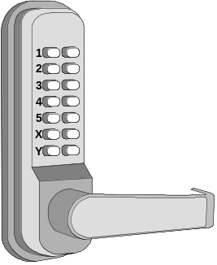
Deriving Use Cases from
System Requirements
REQ1: Keep door locked and auto-lock
REQ2: Lock when “LOCK” pressed
REQ3: Unlock when valid key provided
REQ4: Allow mistakes but prevent dictionary attacks
REQ5: Maintain a history log
REQ6: Adding/removing users at runtime
REQ7: Configuring the device activation preferences
REQ8: Inspecting the access history
REQ9: Filing inquiries
Actor | Actor’s Goal (what the actor intends to accomplish) | Use Case Name
Landlord | To disarm the lock and enter, and get space lighted up. | Unlock (UC-1)
Landlord | To lock the door & shut the lights (sometimes?). | Lock (UC-2)
Landlord | To create a new user account and allow access to home. | AddUser (UC-3)
Landlord | To retire an existing user account and disable access. | RemoveUser (UC-4)
Tenant | To find out who accessed the home in a given interval of time and potentially file complaints. | InspectAccessHistory (UC-5)
Tenant | To disarm the lock and enter, and get space lighted up. | Unlock (UC-1)
Tenant | To lock the door & shut the lights (sometimes?). | Lock (UC-2)
Tenant | To configure the device activation preferences. | SetDevicePrefs (UC-6)
LockDevice | To control the physical lock mechanism. | UC-1, UC-2
LightSwitch | To control the lightbulb. | UC-1, UC-2
[to be identified] | To auto-lock the door if it is left unlocked for a given interval of time. | AutoLock (UC-2)
( Actors already given if working from user stories instead of system requirements )

Slide 31
Types of Actors
Initiating actor (also called primary actor or “user”): initiates the use case to realize a goal
Participating actor (also called secondary actor): participates in the use case but does not initiate it:
  Supporting actor: helps the system-to-be to complete the use case
  Offstage actor: passively participates in the use case, i.e., neither initiates nor helps complete the use case, but may be notified about some aspect of it (e.g., for keeping records)

Slide 32
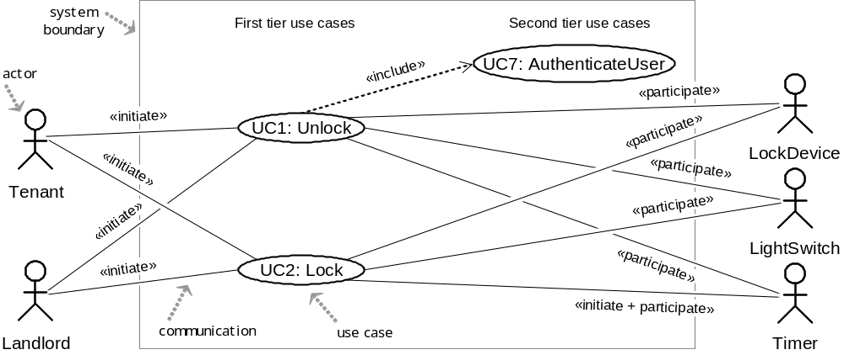
Use Case Diagram: Device Control
UC1: Unlock
UC2: Lock
UC3: AddUser
UC4: RemoveUser
UC5: InspectAccessHistory
UC6: SetDevicePrefs
UC7: AuthenticateUser
UC8: Login

Slide 33
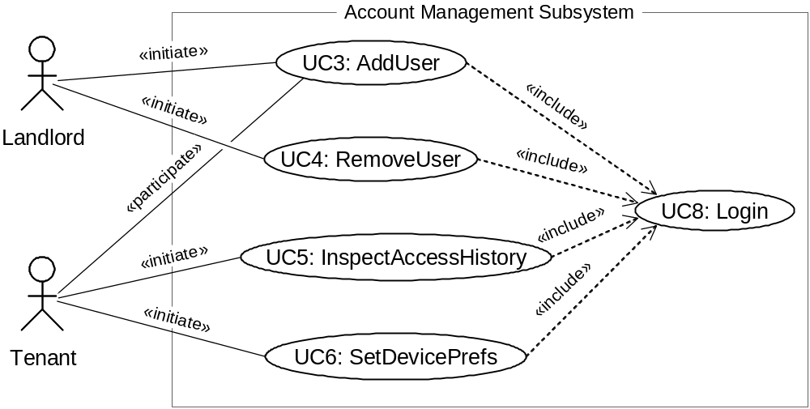
Use Case Diagram: Account Management
UC1: Unlock
UC2: Lock
UC3: AddUser
UC4: RemoveUser
UC5: InspectAccessHistory
UC6: SetDevicePrefs
UC7: AuthenticateUser
UC8: Login

Slide 34
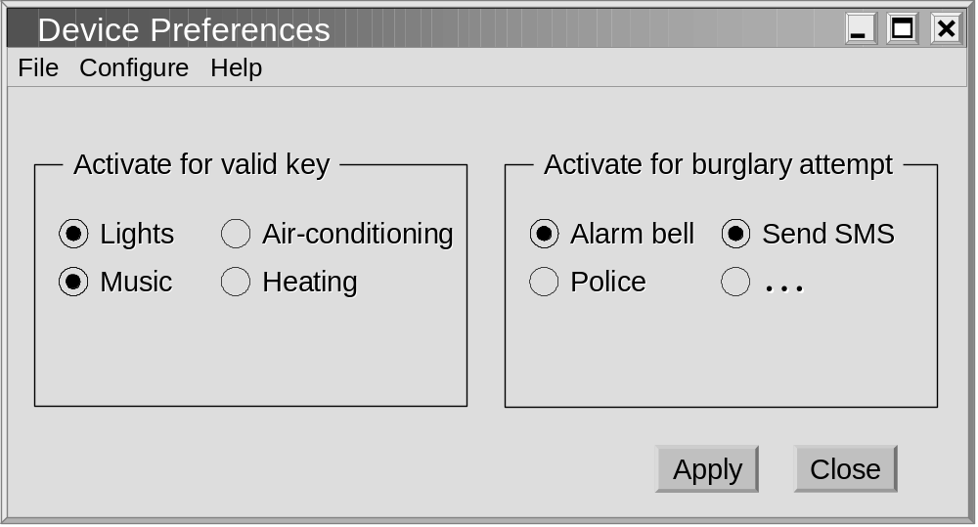
GUI for UC6: Set Device Pref’s
( NOTE: Lock device is mandatory )

Slide 35
Use Case Generalizations
UC1: Unlock
UC2: Lock
UC3: AddUser
UC4: RemoveUser
UC5: InspectAccessHistory
UC6: SetDevicePrefs
UC7: AuthenticateUser
UC8: Login
Resident
ManageUsers
Tenant
Landlord
UC3: AddUser
UC4: RemoveUser
Actor Generalization
Use Case Generalization

Slide 36
Optional Use Cases: «extend»
UC1: Unlock
UC2: Lock
UC3: AddUser
UC4: RemoveUser
UC5: InspectAccessHistory
UC6: SetDevicePrefs
UC7: AuthenticateUser
UC8: Login
Example optional use cases:
UC5: InspectAccessHistory
«extend»
ManageAccount
«extend»
UC6: SetDevicePrefs
Key differences between «include» and «extend» relationships
Included use case
Extending use case
Is this use case optional?
No
Yes
Is the base use case complete without this use case?
No
Yes
Is the execution of this use case conditional?
No
Yes
Does this use case change the behavior of the base use case?
No
Yes
[ Source: Robert Maksimchuk & Eric Naiburg: UML for Mere Mortals, Addison-Wesley, 2005. ]

Slide 37
Login Use Case?
BAD:
GOOD:
Login
AddUser
AddUser
«include»
Login
Landlord
SetDevicePrefs
Landlord
SetDevicePrefs
«include»

Slide 38
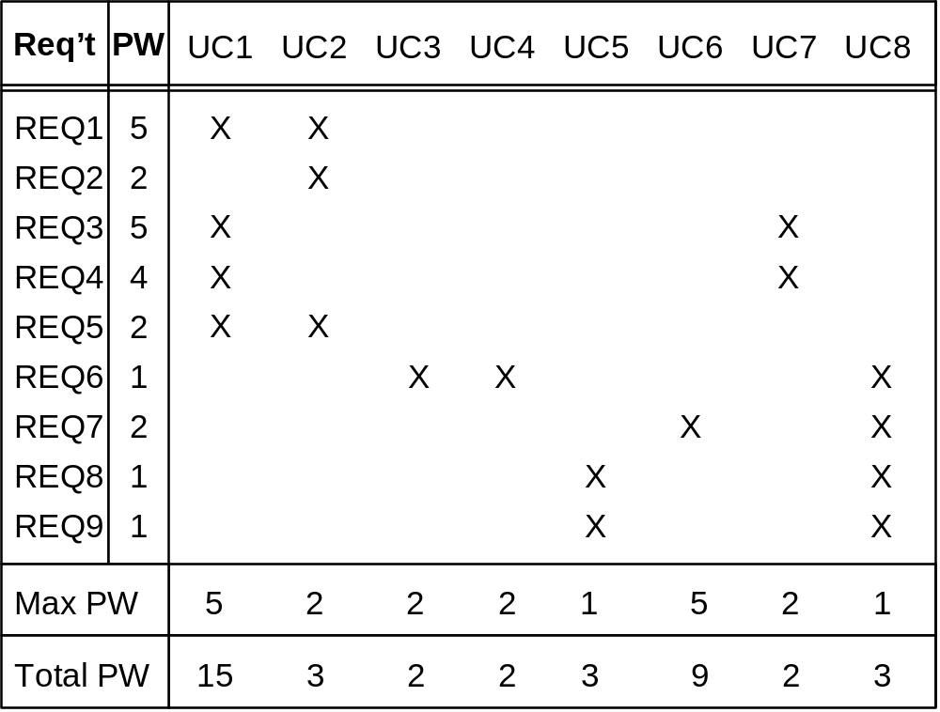
Traceability Matrix (1)
Mapping: System requirements to Use cases
UC1: Unlock
UC2: Lock
UC3: AddUser
UC4: RemoveUser
UC5: InspectAccessHistory
UC6: SetDevicePrefs
UC7: AuthenticateUser
UC8: Login
REQ1: Keep door locked and auto-lock
REQ2: Lock when “LOCK” pressed
REQ3: Unlock when valid key provided
REQ4: Allow mistakes but prevent dictionary attacks
REQ5: Maintain a history log
REQ6: Adding/removing users at runtime
REQ7: Configuring the device activation preferences
REQ8: Inspecting the access history
REQ9: Filing inquiries
Continued for domain model, design diagrams, …

Slide 39
Traceability Matrix Purpose
To check that all requirements are covered by the use cases
To check that none of the use cases is introduced without a reason (i.e., created not in response to any requirement)
To prioritize the work on use cases

Slide 40
Schema for Detailed Use Cases
Use Case UC-#: |  |  |  | Name / Identifier [verb phrase]
Related Requirements: |  |  |  | List of the requirements that are addressed by this use case
Initiating Actor: |  |  |  | Actor who initiates interaction with the system to accomplish a goal
Actor’s Goal: |  |  |  | Informal description of the initiating actor’s goal
Participating Actors: |  |  |  | Actors that will help achieve the goal or need to know about the outcome
Preconditions: |  |  |  | What is assumed about the state of the system before the interaction starts
Postconditions: |  |  |  | What are the results after the goal is achieved or abandoned; i.e., what must be true about the system at the time the execution of this use case is completed
Flow of Events for Main Success Scenario:
→ | 1. | The initiating actor delivers an action or stimulus to the system (the arrow indicates the direction of interaction, to- or from the system)
← | 2. | The system’s reaction or response to the stimulus; the system can also send a message to a participating actor, if any
→ | 3. | …
Flow of Events for Extensions (Alternate Scenarios): What could go wrong? List the exceptions to the routine and describe how they are handled
→ | 1a. | For example, actor enters invalid data
← | 2a. | For example, power outage, network failure, or requested data unavailable
 |  | …
The arrows on the left indicate the direction of interaction: → Actor’s action; ← System’s reaction

Slide 41
Use Case 1: Unlock
Use Case UC-1: |  |  | Unlock
Related Requirem’ts: |  |  | REQ1, REQ3, REQ4, and REQ5 stated in Table 2-1
Initiating Actor: |  |  | Any of: Tenant, Landlord
Actor’s Goal: |  |  | To disarm the lock and enter, and get space lighted up automatically.
Participating Actors: |  |  | LockDevice, LightSwitch, Timer
Preconditions: |  |  | • The set of valid keys stored in the system database is non-empty. • The system displays the menu of available functions; at the door keypad the menu choices are “Lock” and “Unlock.”
Postconditions: |  |  | The auto-lock timer has started countdown from autoLockInterval.
Flow of Events for Main Success Scenario:
→ | 1. | Tenant/Landlord arrives at the door and selects the menu item “Unlock”
 | 2. | include::AuthenticateUser (UC-7)
← | 3. | System (a) signals to the Tenant/Landlord the lock status, e.g., “disarmed,” (b) signals to LockDevice to disarm the lock, and (c) signals to LightSwitch to turn the light on
← | 4. | System signals to the Timer to start the auto-lock timer countdown
→ | 5. | Tenant/Landlord opens the door, enters the home [and shuts the door and locks]

Slide 42
Subroutine «include» Use Case
Use Case UC-7: |  |  |  | AuthenticateUser (sub-use case)
Related Requirements: |  |  |  | REQ3, REQ4 stated in Table 2‑1
Initiating Actor: |  |  |  | Any of: Tenant, Landlord
Actor’s Goal: |  |  |  | To be positively identified by the system (at the door interface).
Participating Actors: |  |  |  | AlarmBell, Police
Preconditions: |  |  |  | • The set of valid keys stored in the system database is non-empty. • The counter of authentication attempts equals zero.
Postconditions: |  |  |  | None worth mentioning.
Flow of Events for Main Success Scenario:
← | 1. | System prompts the actor for identification, e.g., alphanumeric key
→ | 2. | Tenant/Landlord supplies a valid identification key
← | 3. | System (a) verifies that the key is valid, and (b) signals to the actor the key validity
Flow of Events for Extensions (Alternate Scenarios):
2a. Tenant/Landlord enters an invalid identification key
← | 1. | System (a) detects error, (b) marks a failed attempt, and (c) signals to the actor
← |  | 1a. | System (a) detects that the count of failed attempts exceeds the maximum allowed number, (b) signals to sound AlarmBell, and (c) notifies the Police actor of a possible break-in
→ | 2. | Tenant/Landlord supplies a valid identification key
 | 3. | Same as in Step 3 above

Slide 43
Acceptance Test Case for
UC-7 Authenticate User
Test-case Identifier: | TC-1
Use Case Tested: | UC-1, main success scenario, and UC-7
Pass/fail Criteria: | The test passes if the user enters a key that is contained in the database, with less than a maximum allowed number of unsuccessful attempts
Input Data: | Numeric keycode, door identifier
Test Procedure: |  | Expected Result:
Step 1. Type in an incorrect keycode and a valid door identifier |  | System beeps to indicate failure; records unsuccessful attempt in the database; prompts the user to try again
Step 2. Type in the correct keycode and door identifier |  | System flashes a green light to indicate success; records successful access in the database; disarms the lock device

Slide 44
Use Case 2: Lock
Use Case UC-2: |  |  | Lock
Related Requirements: |  |  | REQ1, REQ2, and REQ5 stated in Table 2-1
Initiating Actor: |  |  | Any of: Tenant, Landlord, or Timer
Actor’s Goal: |  |  | To lock the door & get the lights shut automatically (?)
Participating Actors: |  |  | LockDevice, LightSwitch, Timer
Preconditions: |  |  | The system always displays the menu of available functions.
Postconditions: |  |  | The door is closed and lock armed & the auto-lock timer is reset.
Flow of Events for Main Success Scenario:
→ | 1. | Tenant/Landlord selects the menu item “Lock”
← | 2. | System (a) signals affirmation, e.g., “lock armed,” (b) signals to LockDevice to arm the lock (if not already armed), (c) signal to Timer to reset the auto-lock counter, and (d) signals to LightSwitch to turn the light off (?)
Flow of Events for Extensions (Alternate Scenarios):
2a. System senses that the door is not closed, so the lock cannot be armed
← | 1. | System (a) signals a warning that the door is open, and (b) signal to Timer to start the alarm counter
→ | 2. | Tenant/Landlord closes the door
← | 3. | System (a) senses the closure, (b) signals affirmation to the Tenant/Landlord, (c) signals to LockDevice to arm the lock, (d) signal to Timer to reset the auto-lock counter, and (e) signal to Timer to reset the alarm counter

Slide 45
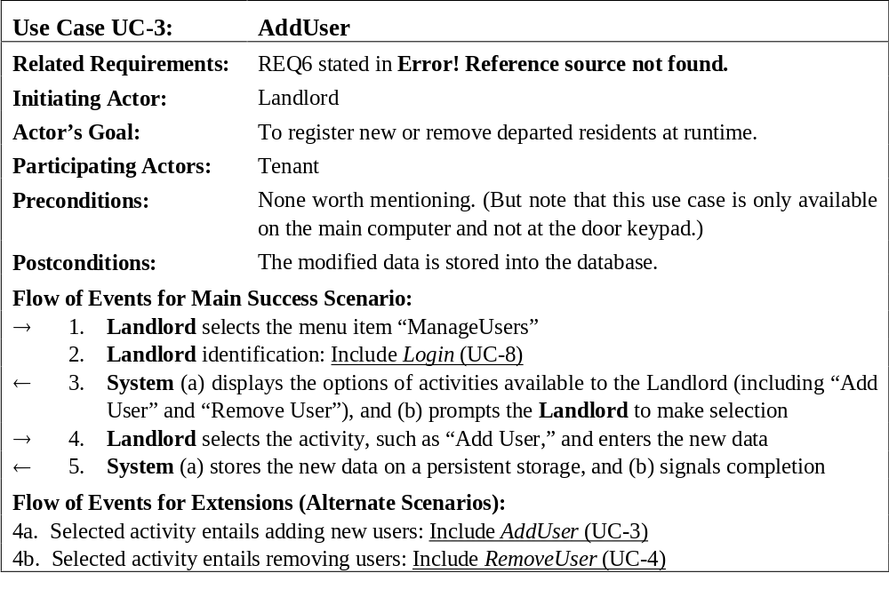
Use Case 3: Add User

Slide 46
Use Case 5: Inspect Access History
Use Case UC-5: |  |  | Inspect Access History
Related Requirements: |  |  | REQ8 and REQ9 stated in Table 2-1
Initiating Actor: |  |  | Any of: Tenant, Landlord
Actor’s Goal: |  |  | To examine the access history for a particular door.
Participating Actors: |  |  | Database, Landlord
Preconditions: |  |  | Tenant/Landlord is logged in the system and is shown a hyperlink “View Access History.”
Postconditions: |  |  | None.
Flow of Events for Main Success Scenario:
→ | 1. | Tenant/Landlord clicks the hyperlink “View Access History”
← | 2. | System prompts for the search criteria (e.g., time frame, door location, actor role, event type, etc.) or “Show all”
→ | 3. | Tenant/Landlord specifies the search criteria and submits
← | 4. | System prepares a database query that best matches the actor’s search criteria and retrieves the records from the Database
→ | 5. | Database returns the matching records
← | 6. | System (a) additionally filters the retrieved records to match the actor’s search criteria; (b) renders the remaining records for display; and (c) shows the result for Tenant/Landlord’s consideration
→ | 7. | Tenant/Landlord browses, selects “interesting” records (if any), and requests further investigation (with an accompanying complaint description)
← | 8. | System (a) displays only the selected records and confirms the request; (b) archives the request in the Database and assigns it a tracking number; (c) notifies Landlord about the request; and (d) informs Tenant/Landlord about the tracking number

Slide 47
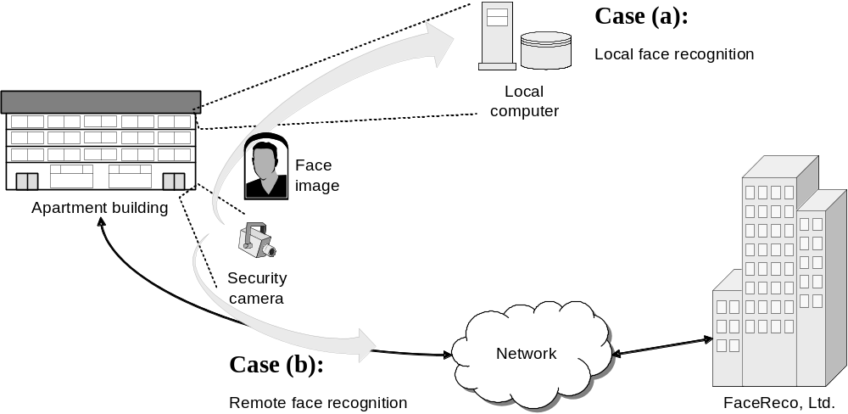
System Boundary & Subsystems
Use Case Variations Example:

Slide 48
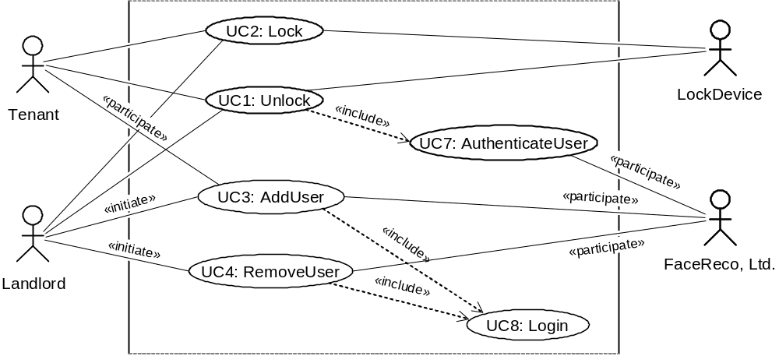
Modified Use Case Diagram
UC1: Unlock
UC2: Lock
UC3: AddUser
UC4: RemoveUser
UC5: InspectAccessHistory
UC6: SetDevicePrefs
UC7: AuthenticateUser
UC8: Login
Authentication subsystem (FaceReco, Ltd.)
is externalized from the system-to-be:

Slide 49
Security and Risk Management
Identifying and preempting the serious risks to system’s safe and successful functioning
Risk types:
  Intolerable
  As low as reasonably practical (ALARP)
  Acceptable
Example abuse case input sequence:
    invalid-key, invalid-key, … ≤ maxNumOfAttempts ;
    wait maxAttemptPeriod ; invalid-key, invalid-key, …

Slide 50
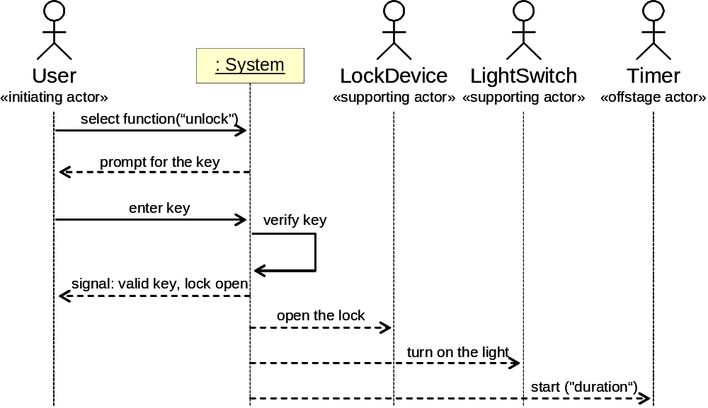
System Sequence Diagram
[Modeling System Workflows]
Use case: Unlock
Main success scenario
Similar to UML sequence diagrams,
but for actor interactions instead of software object interactions

Slide 51
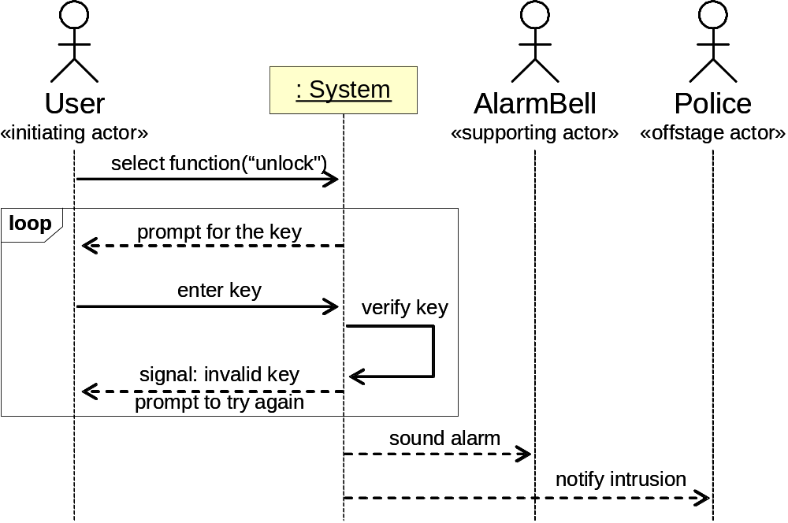
System Sequence Diagram
[Modeling System Workflows]
Use case: Unlock
Alternate scenario (burglary attempt)

Slide 52
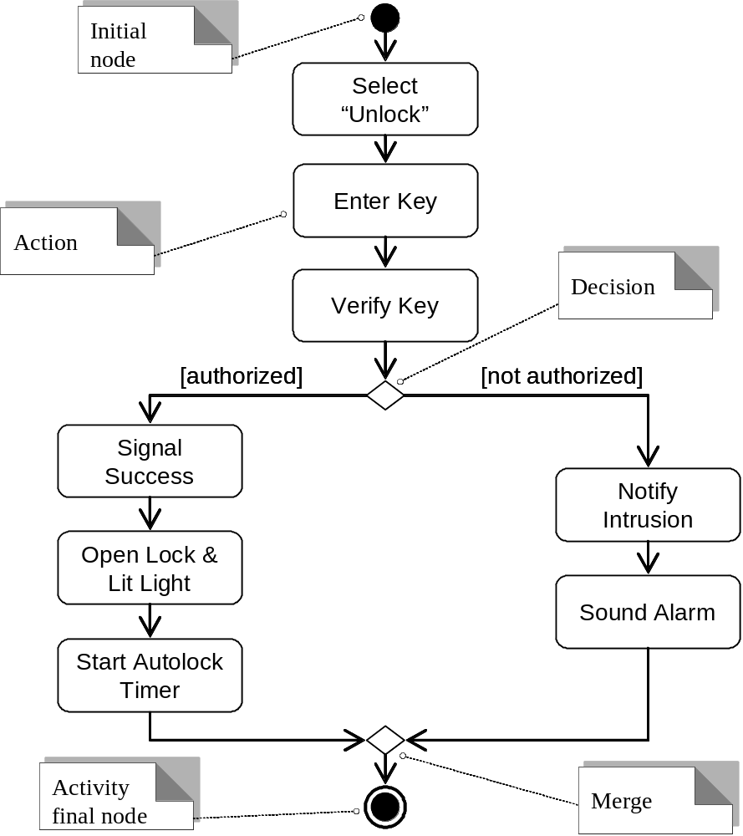
Activity Diagram
[Modeling System Workflows]

